Slide 1
TwinEngines ETrans Migration
Reasons for migration
New/improved look and feel
CCRIs forcing SFTP connections to SIDPERS FTP
Out-dated technology causing problems with Windows 10 & IE in some states
Old system will have no future updates
Ex. PHYS_CAT now allows ALL values and no checks done against PULHES. This change has been incorporated into the new version of ETrans Mgr.
Accreditation done on new version of ETrans
Accreditation required some code changes like automatically expiring user accounts.
Old system accreditation has expired
Notes:
NOTE: This presentation includes animations and is best viewed by starting the slideshow.

Slide 2
TwinEngines Etrans Migration
New Functionality
Built on top of Case Management technology that allows attaching documents and tasking
Amendment/Revocation cases
Automatically created when orders are amended/revoked in MILPO Orders
Users are assigned a task to investigate if electronic transaction needs to be rolled back
DSCH/SEP cases
Special case for DSCH/SEP transactions
Checks for Soldiers that are on Active Duty or Flagged and holds them to avoid having them rejected by SIDPERS

Slide 3
TwinEngines ETrans Migration
New Functionality (continued)
TRF cases
Special case for TRF transaction
Checks for Soldiers that are attached holds them to avoid having them rejected by SIDPERS
Ability to create case types like DSCH/SEP/TRF and create custom rules/tasking

Slide 4
TwinEngines ETrans Migration Installation
Request key from dbaskin@twinengines.com
Download latest version of TwinEnginesWebSetup from http://nationalguard.twinengines.com
Support -> Downloads
Run the TwinEnginesWebSetup on the web server
Installation will prompt for SQL login/password for the application to use and a SQL administrative login to create/update database
Also prompted for an application Administrator account that will have rights to assign users in the system
Installation does NOT affect old version of ETrans and can be run concurrently

Slide 5
TwinEngines Etrans Migration Accessing the Site
After installation, a new website is created called “TwinEngines”.
Old URL: https://servername/cmswebservices
New URL: https://servername/twinengines
If you get a “Confirm your Identity” web page, you do not have roles to access the website.
Confirm your identity by putting in your SSN and finding your SIDPERS record, plus entering your email address.
This creates a user account in the system for you, then a TwinEngines Admin (created during install) can give you the ETrans Manager roles.

Slide 6
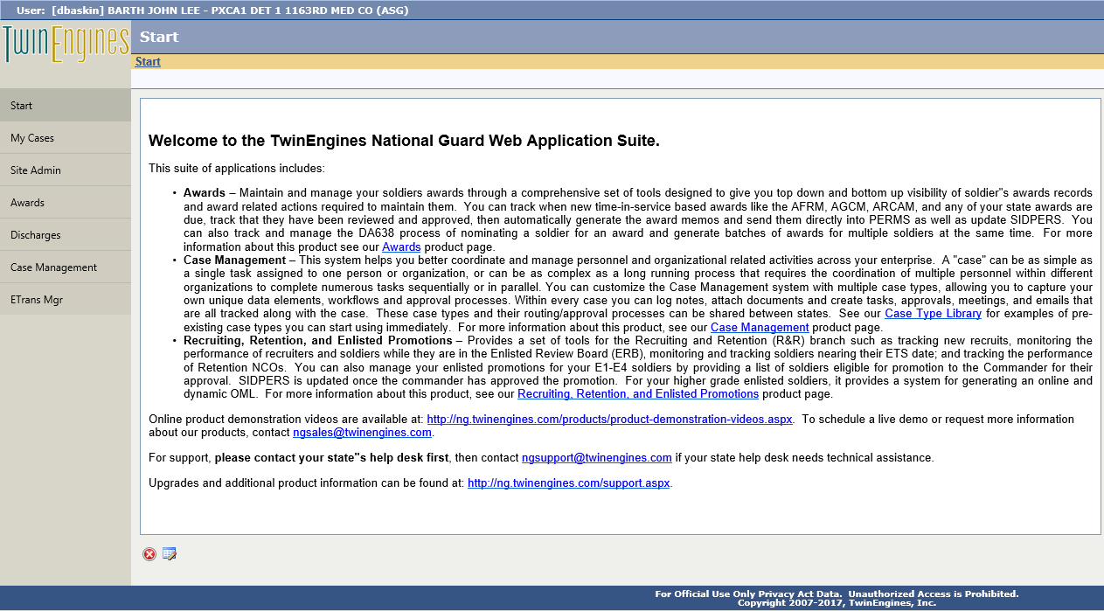
TwinEngines ETrans Migration New Website
New website looks like this
Click the Etrans Mgr tab
This page and the icon in the upper left corner are customizable by clicking here

Slide 7
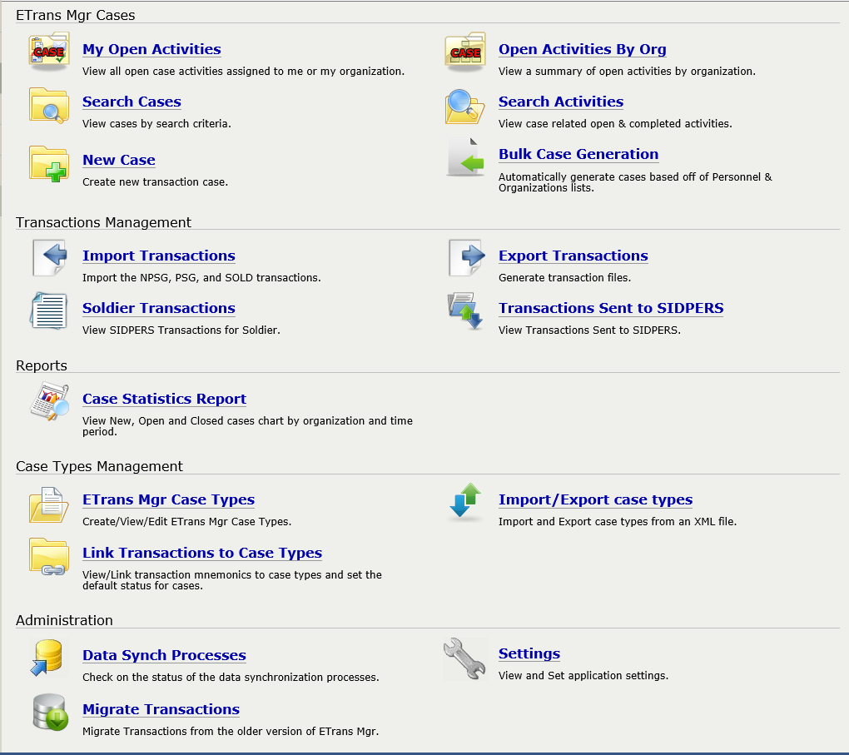
TwinEngines ETrans Migration Main Page
Transactions are created as “Cases” in the system and can be found here
This area is where you import gains transactions, export them to SIDPERS, and reconcile them once the upsin process has run
Need to configure Settings

Slide 8
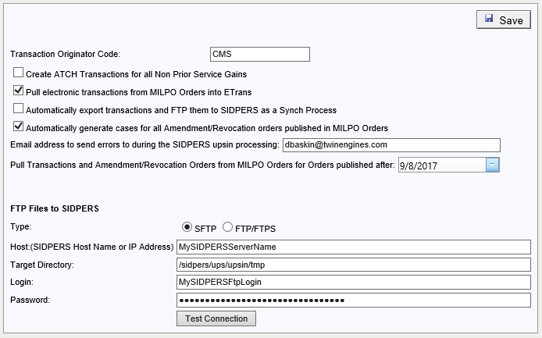
TwinEngines ETrans Migration Settings
Uncheck this option if you don’t want to have Amendment and Revocation cases created
Set this date to the day you want to cut over to the new system
You will need to select the SFTP option if your state has gone through a CCRI or is preparing for one

Slide 9
TwinEngines ETrans Migration Migrating Data
Use the Migrate Transactions option to bring your transactions over from the old Etrans system

Slide 10
TwinEngines ETrans Migration Migrating Data
By default, the system will migrate historical data from the previous 2 years. You can change this date if you want to maintain more historical data in the new system.
You can run the migration multiple times and wipe out the old data prior to importing it again.
Click here to start the migration process.

Slide 11
TwinEngines ETrans Migration Migrating Data
You can see the migrated transactions here

Slide 12
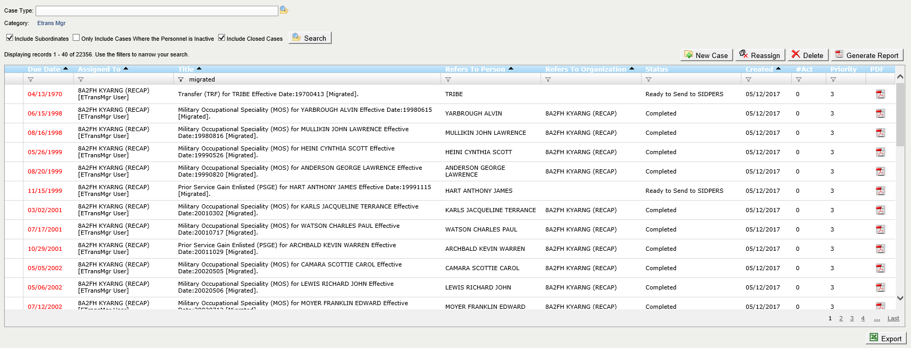
TwinEngines ETrans Migration Migrating Data
Transactions that have been migrated will include “[Migrated]” in the title of the case. You can filter the records with the filter icon at the top of the grid.
Transactions that have already been sent to SIDPERS will be brought over in a “Completed” status. Check the “Include Closed Cases” to see these cases.

Slide 13
TwinEngines ETrans Migration Importing Gains
Use the Import Transactions function to import new gain transactions

Slide 14
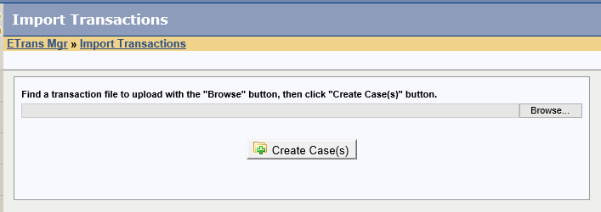
TwinEngines ETrans Migration Importing Gains
Use the “Browse” button to access the ARISS share on your PERMS server to import the NPSG and PSG transaction files.

Slide 15
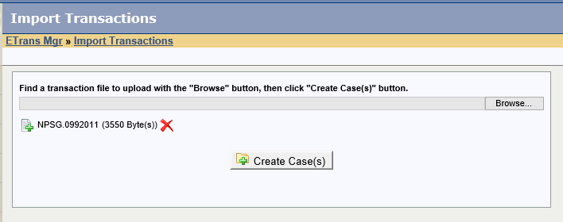
TwinEngines ETrans Migration Importing Gains
Click “Create Cases” to import the gains transactions from the file.

Slide 16
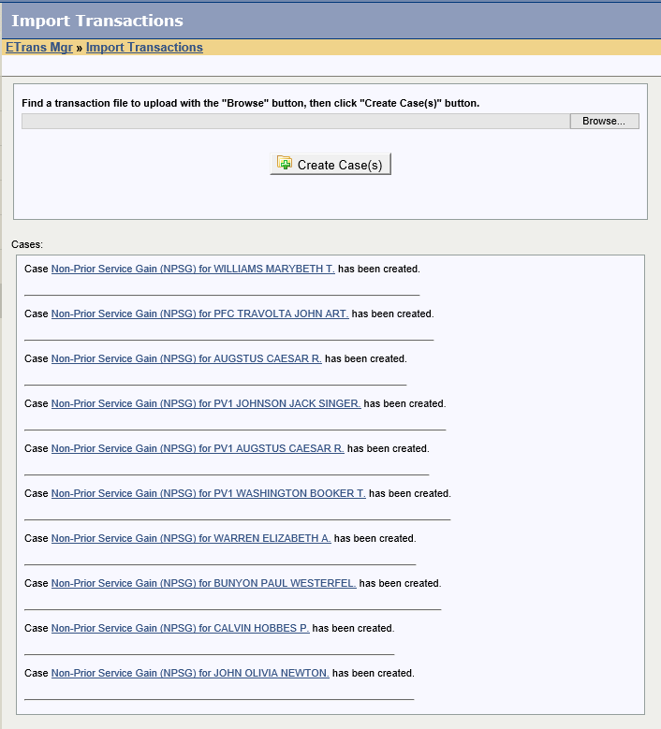
TwinEngines ETrans Migration Importing Gains
Gain transaction cases are created and shown here. You can click on the link to open them.

Slide 17
TwinEngines ETrans Migration Importing Gains
You can also see all gain cases here.

Slide 18
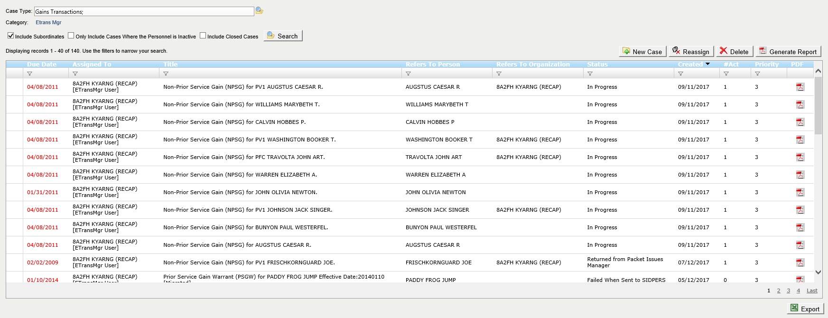
TwinEngines ETrans Migration Importing Gains
You can filter on just gain cases here.
Double click to open the case.

Slide 19
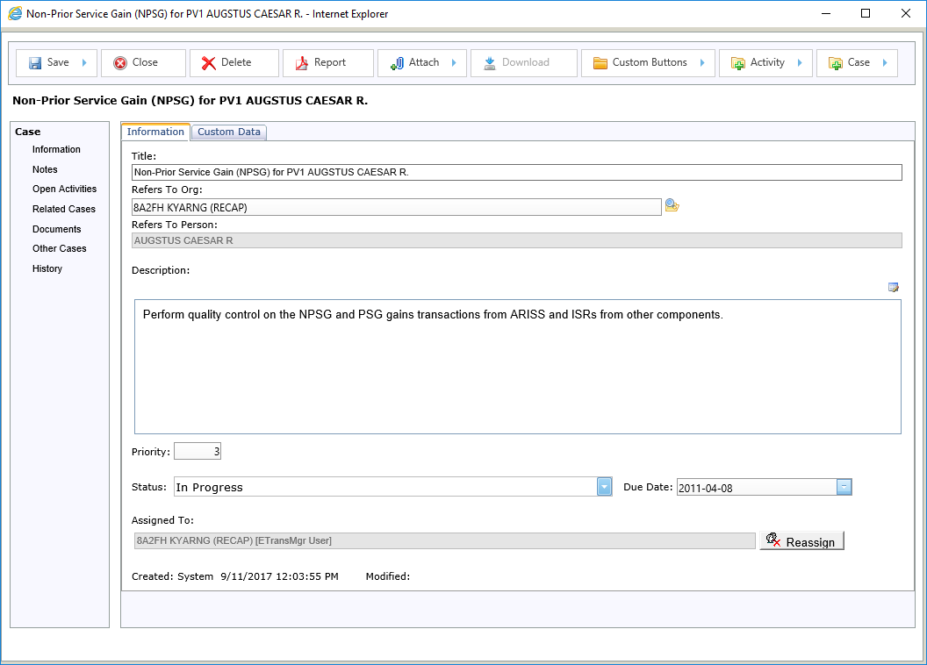
TwinEngines ETrans Migration Processing Gains
Create new cases for the same Soldier from here.
You can create ad-hoc activities (e.g. Tasks, Approvals, etc.) from here.
Download them from here.
Buttons can be customized for each type of case. Look here for functions that are unique to the type case you are currently working on.
This is the case screen for the TwinEngines Case Management system. All cases within the TwinEngines systems (e.g. Awards, Discharges, Etrans) have the same capabilities.
Attach documents here.
View the current activities (e.g. Tasks, Approvals, etc.) here.
Add/View notes here.
Let’s look at the Activities for this case.
View and link other cases in the system to this case from here.
View all documents attached to the case from here
View all cases on the Soldier from here
View the audit history for this case from here

Slide 20
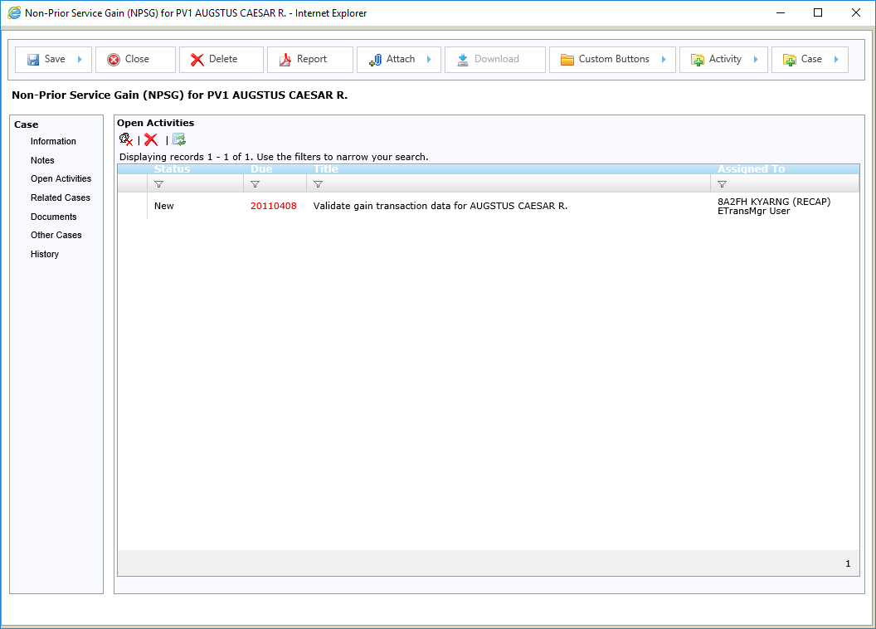
TwinEngines ETrans Migration Processing Gains
A single task is assigned to the Etrans Manager User at your state recap to validate the transaction.

Slide 21
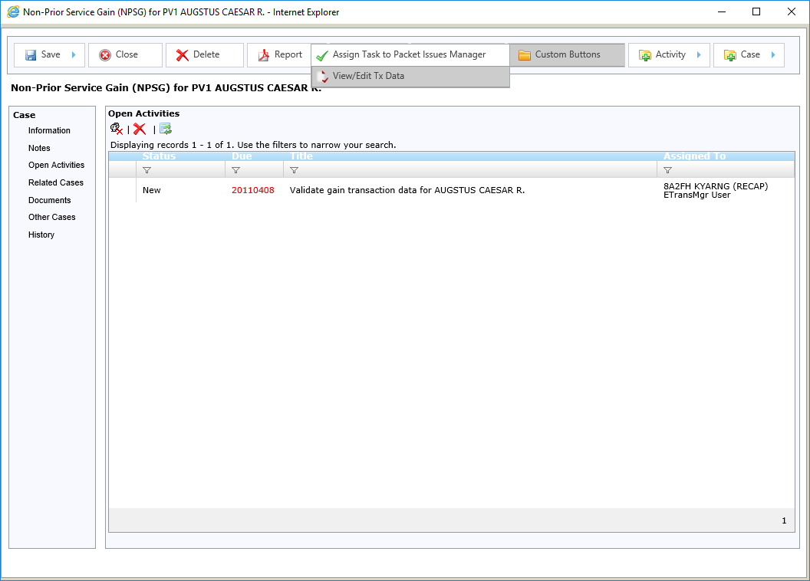
TwinEngines ETrans Migration Processing Gains
Use the View/Edit Tx “Custom Button” to validate the transaction

Slide 22
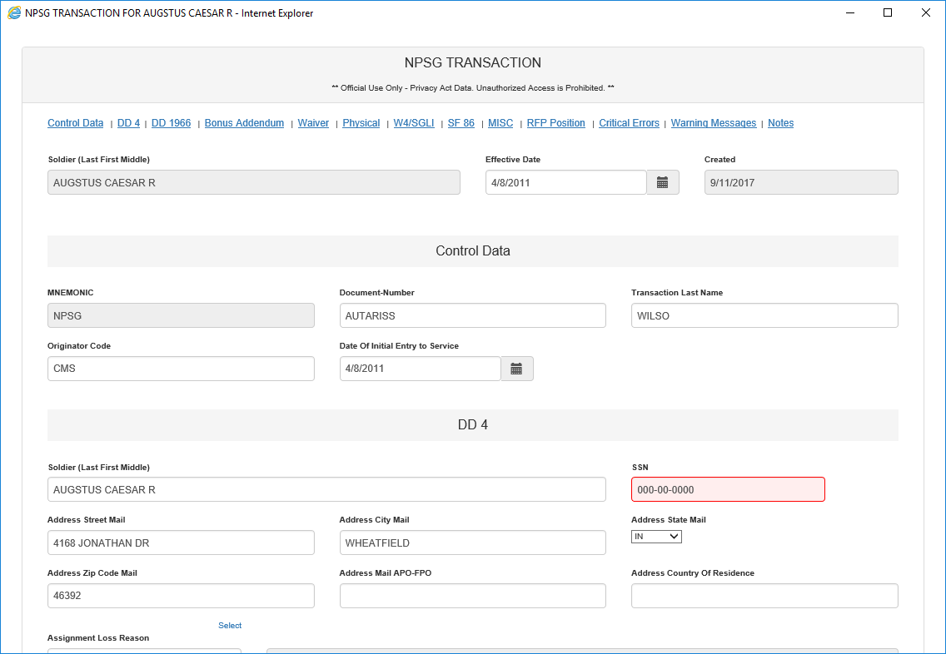
TwinEngines ETrans Migration Processing Gains
This page allows you to view the transaction data and correct any validation errors.
You can jump to any section on the page from these links here.

Slide 23
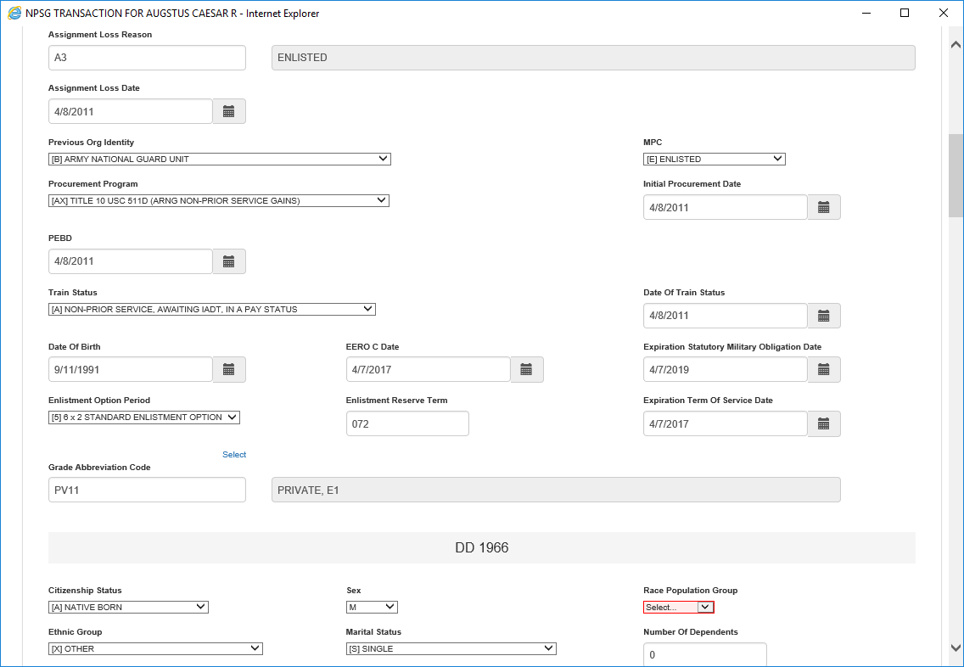
TwinEngines ETrans Migration Processing Gains

Slide 24
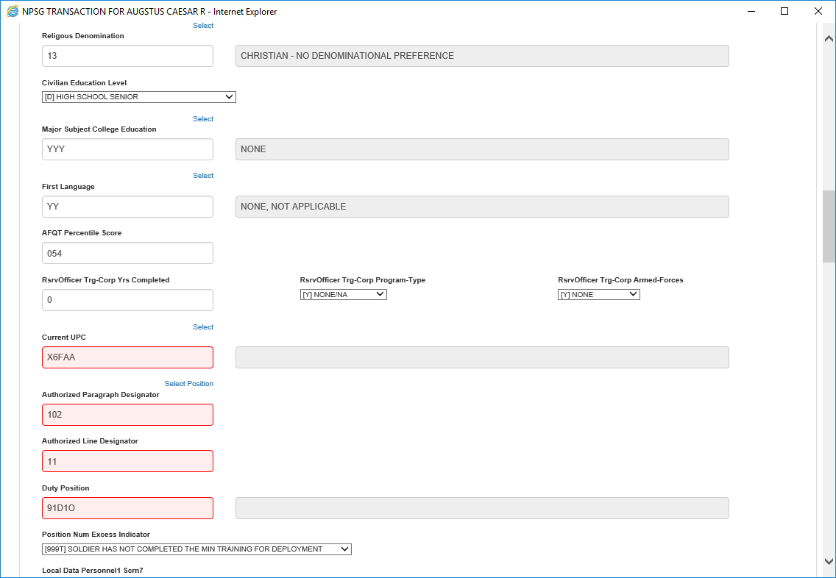
TwinEngines ETrans Migration Processing Gains

Slide 25
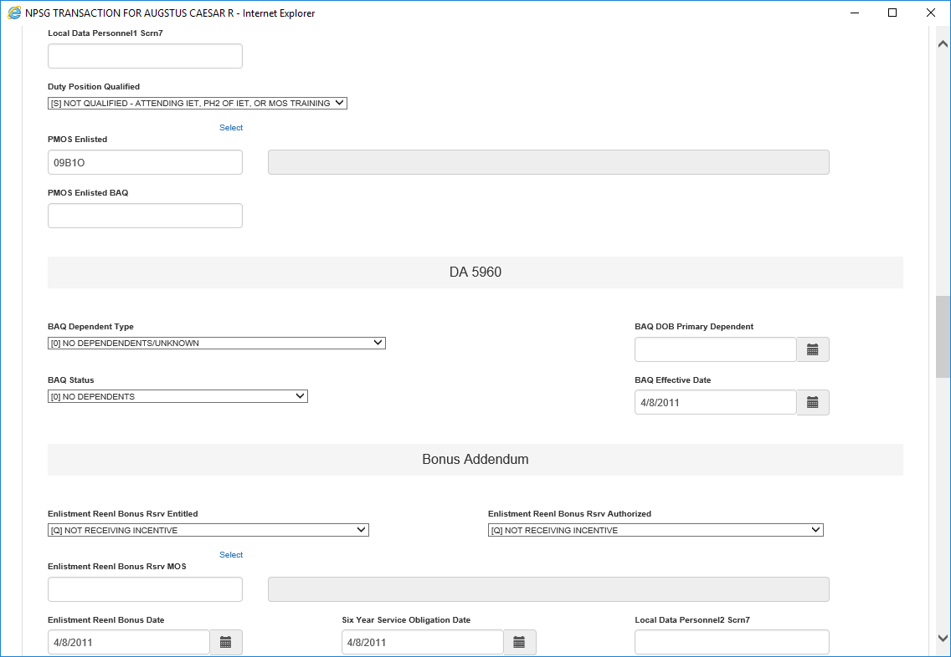
TwinEngines ETrans Migration Processing Gains

Slide 26
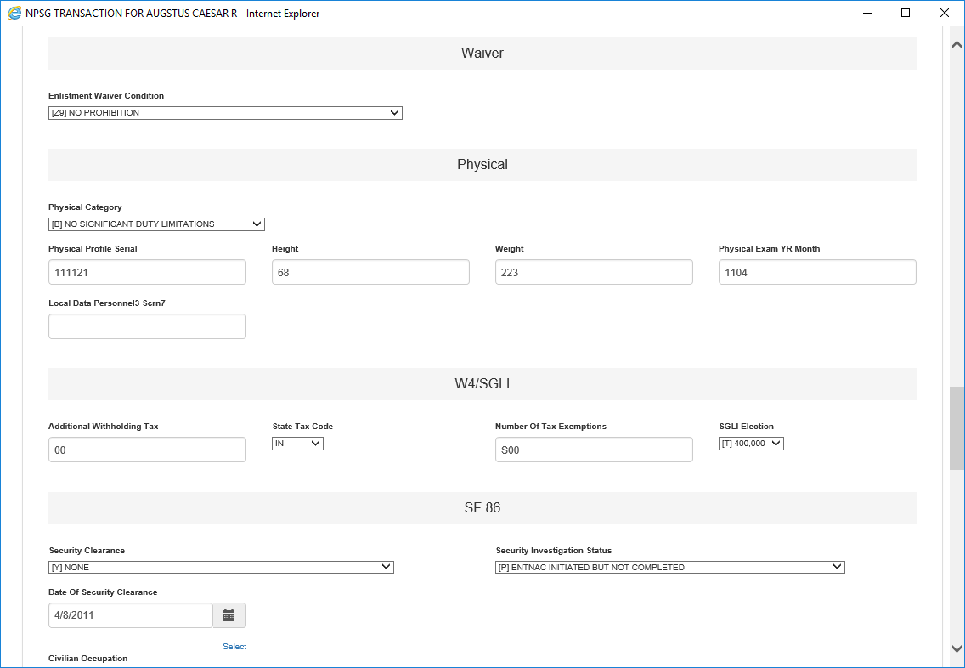
TwinEngines ETrans Migration Processing Gains

Slide 27
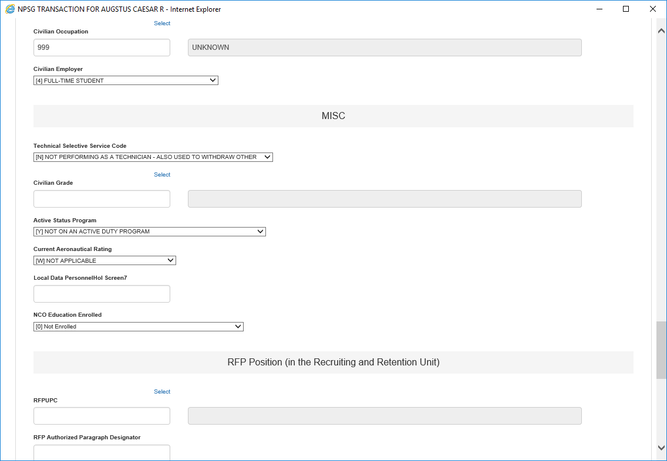
TwinEngines ETrans Migration Processing Gains

Slide 28
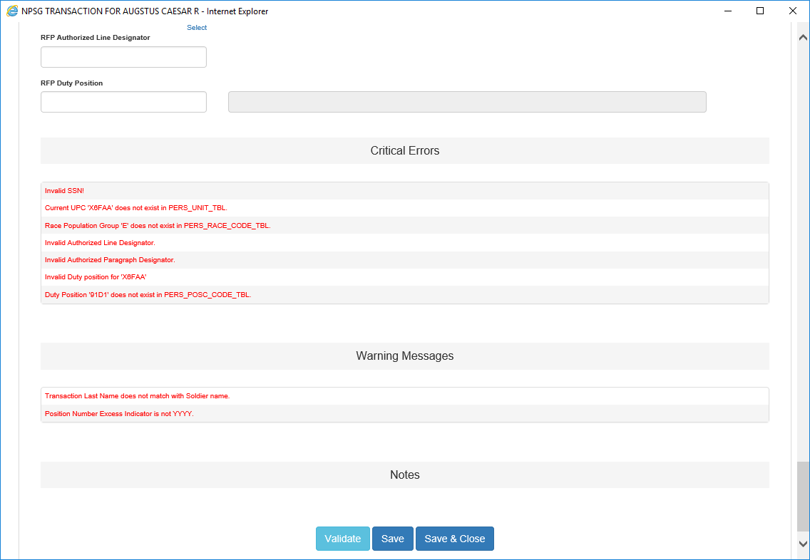
TwinEngines ETrans Migration Processing Gains
Clicking on validation errors will take you directly to the data that has the issue.
The “Validate” button will re-validate the data after you have corrected items.

Slide 29
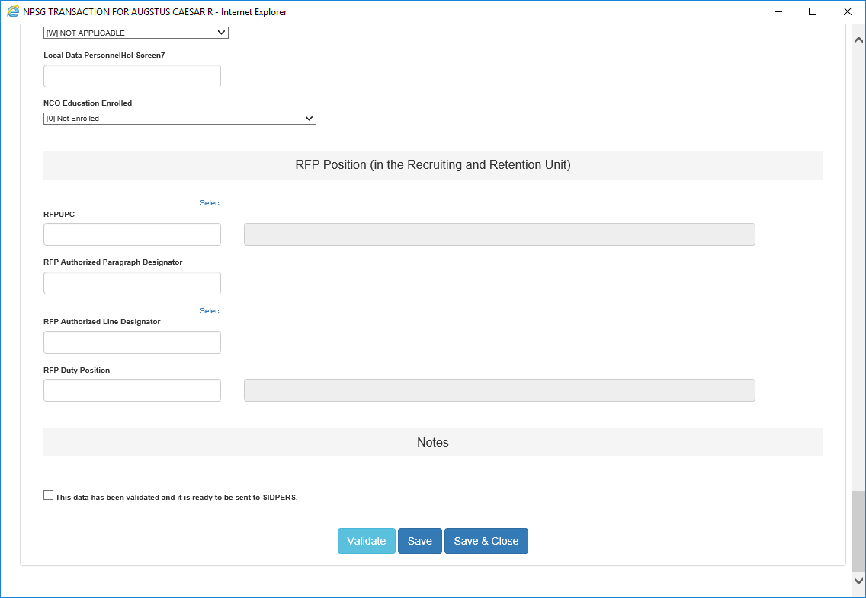
TwinEngines ETrans Migration Processing Gains
Once all the validation errors have been corrected, click here and save to move the case into the “Ready to Send to SIDPERS” queue.

Slide 30
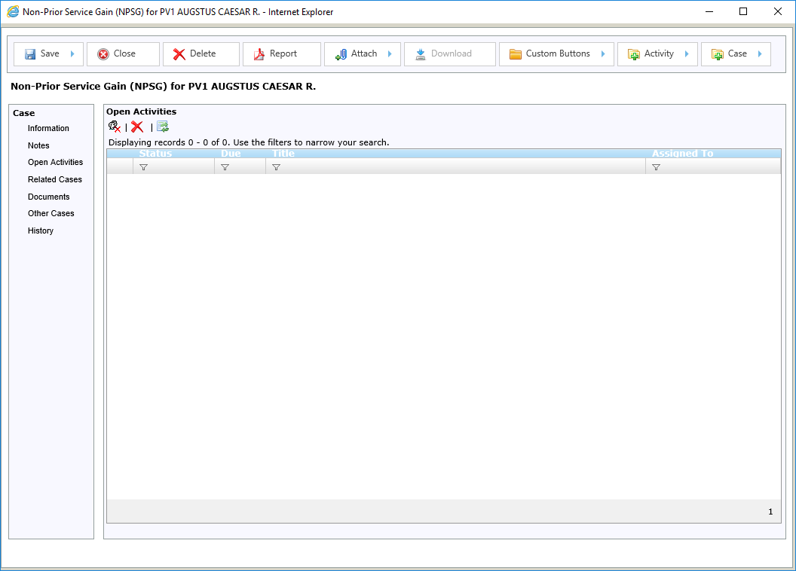
TwinEngines ETrans Migration Processing Gains
The task to validate the transaction is marked as completed.

Slide 31
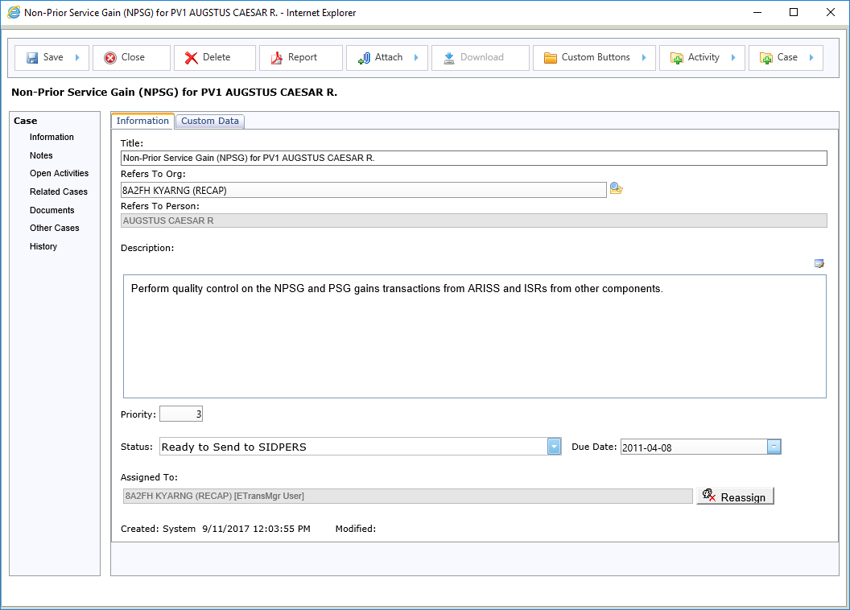
TwinEngines ETrans Migration Processing Gains
The status for the case is set to “Ready to Send to SIDPERS”.

Slide 32
TwinEngines ETrans Migration Exporting Transactions
Click here to export the transactions and send them to SIDPERS.

Slide 33
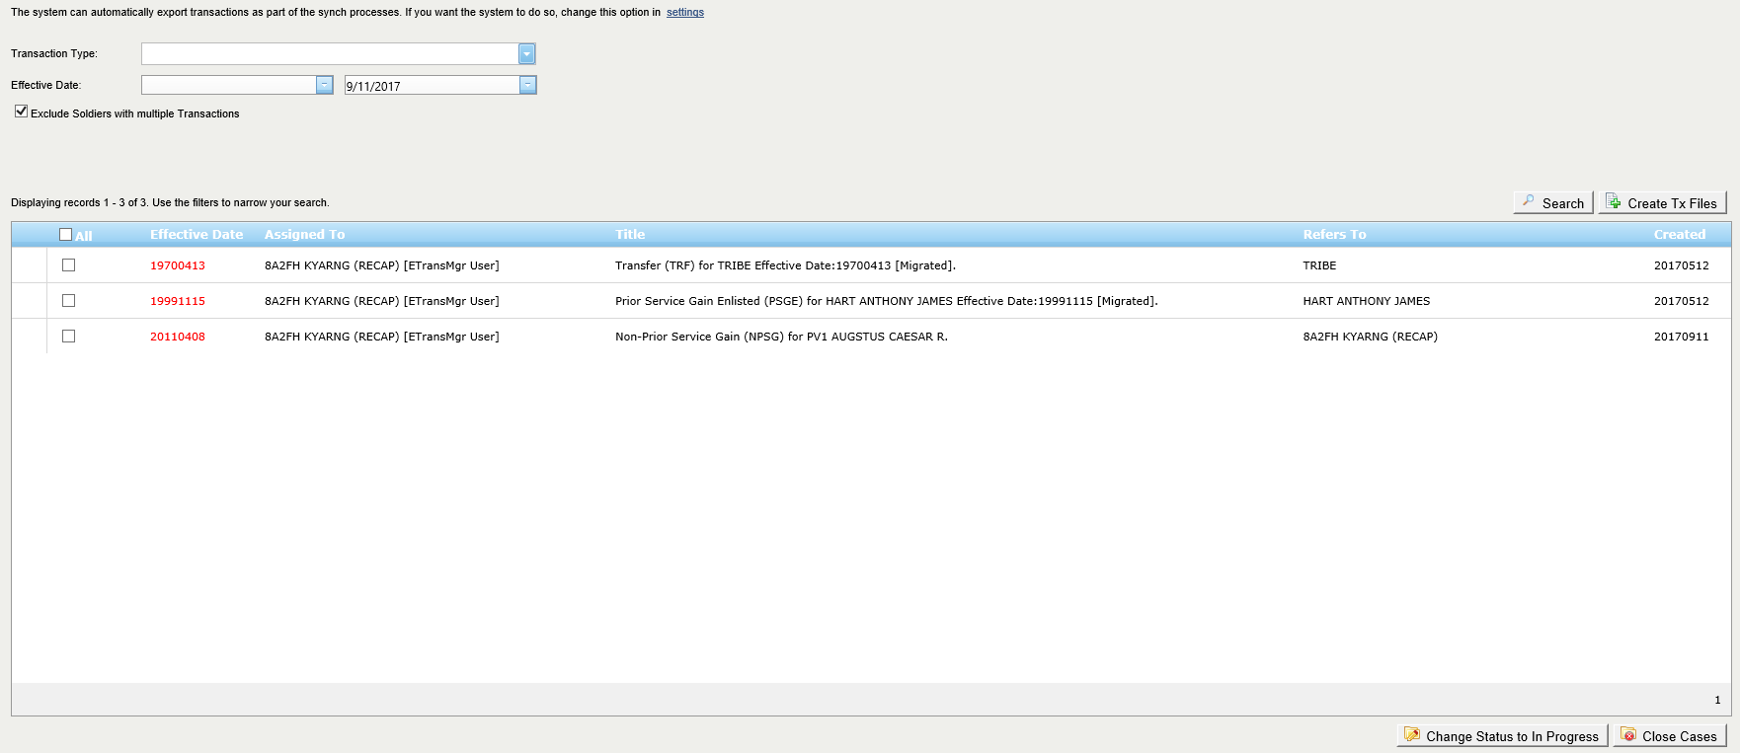
TwinEngines ETrans Migration Exporting Transactions
This is a new feature that allows you to identify multiple transactions getting sent to SIDPERS for the same Soldier on the same day. In some scenarios, that can cause issues with Pay.
Click here to create the transaction files and FTP them up to SIDPERS.
You have various options to filter records here.
Select the records you want to send to SIDPERS.

Slide 34
TwinEngines ETrans Migration Exporting Transactions
Click here to see the transactions that have been sent to SIDPERS and to run the reconcile process to ensure they made it into SIDPERS.

Slide 35
TwinEngines ETrans Migration Exporting Transactions
Click here to run the reconcile process to ensure the transactions made it into SIDPERS. The SIDPERS table, PERS_TRANS_HIST_TBL, is queried for the transactions. If the transaction is found in this table, the case is marked as completed and removed from this screen. If the transaction is not found, the case will be marked as “Failed”.

Slide 36
TwinEngines ETrans Migration Exporting Transactions
For transactions that failed, you can check the “Resend” box and “Save” to put them back on the Export Transactions screen.

Slide 37
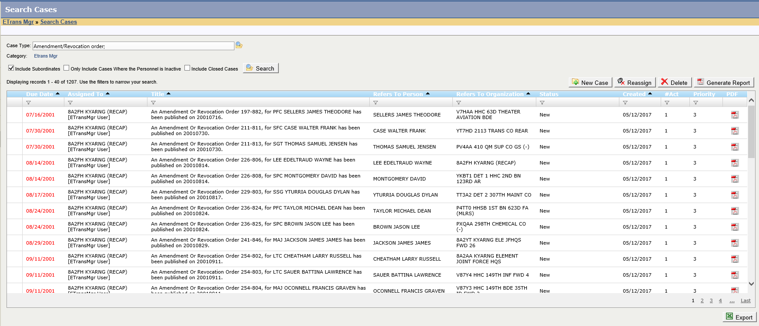
TwinEngines ETrans Migration Amendment/Revocation Cases
Amendment/Revocation cases can be automatically created when an order is published in MILPO Orders.

Slide 38
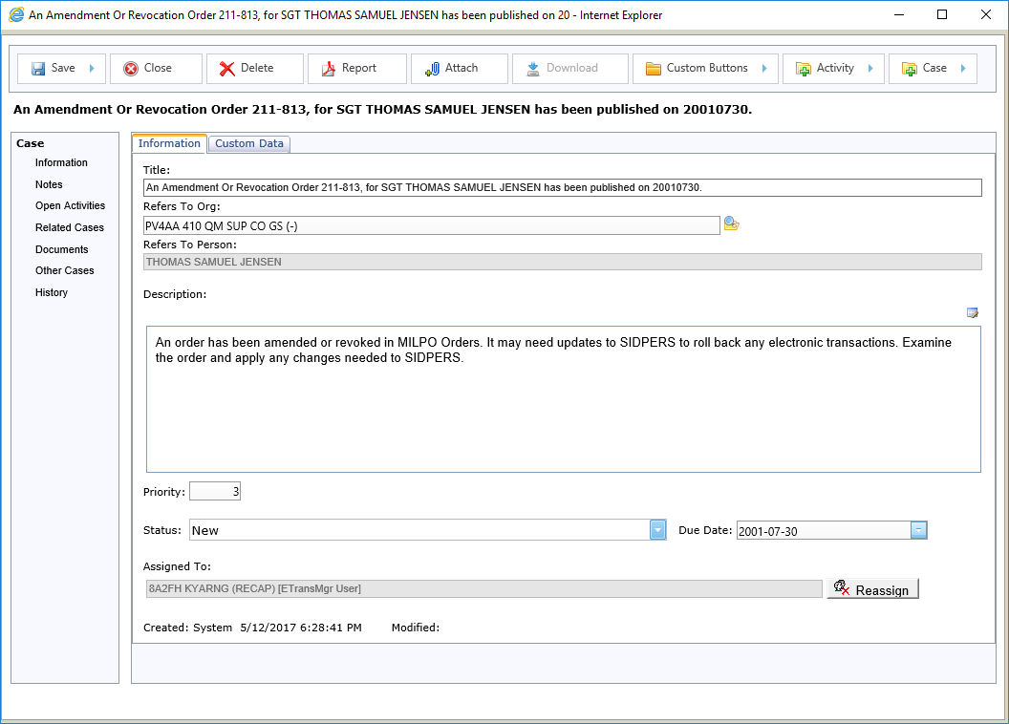
TwinEngines ETrans Migration Amendment/Revocation Cases
Note the description on the case that explains why the case was created.

Slide 39
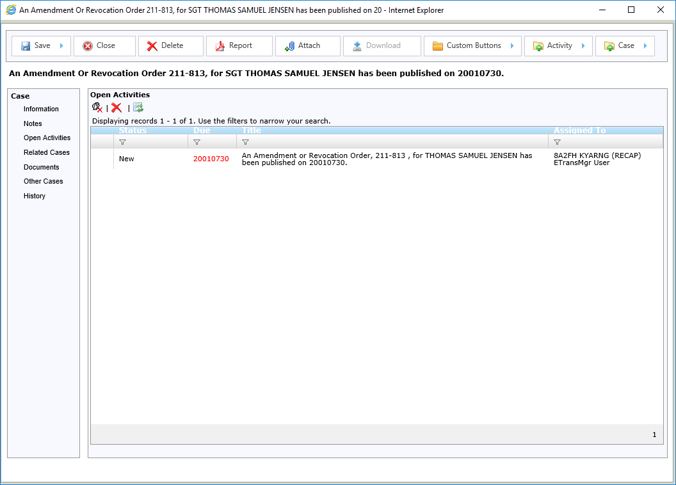
TwinEngines ETrans Migration Amendment/Revocation Cases
A single activity is created to review the order and ensure that no transaction needs to be rolled back in SIDPERS.

Slide 40
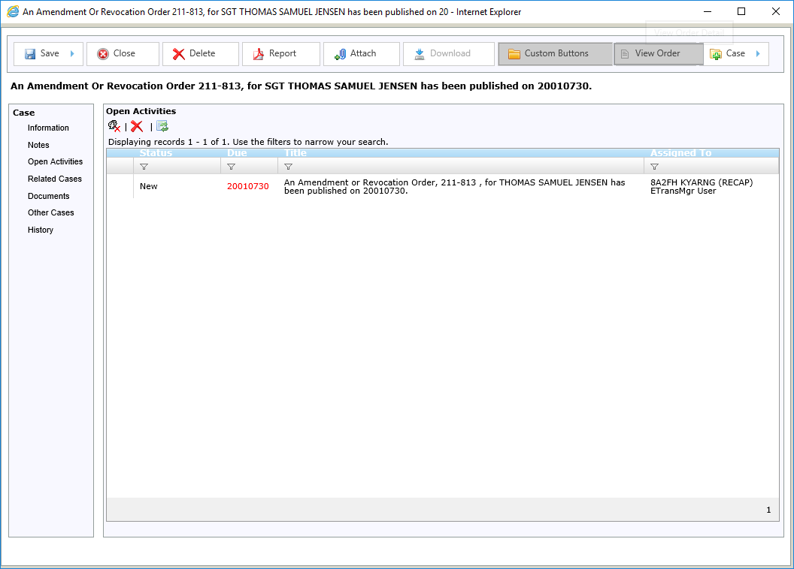
TwinEngines ETrans Migration Amendment/Revocation Cases
You can view the order directly from the View Order button.

Slide 41
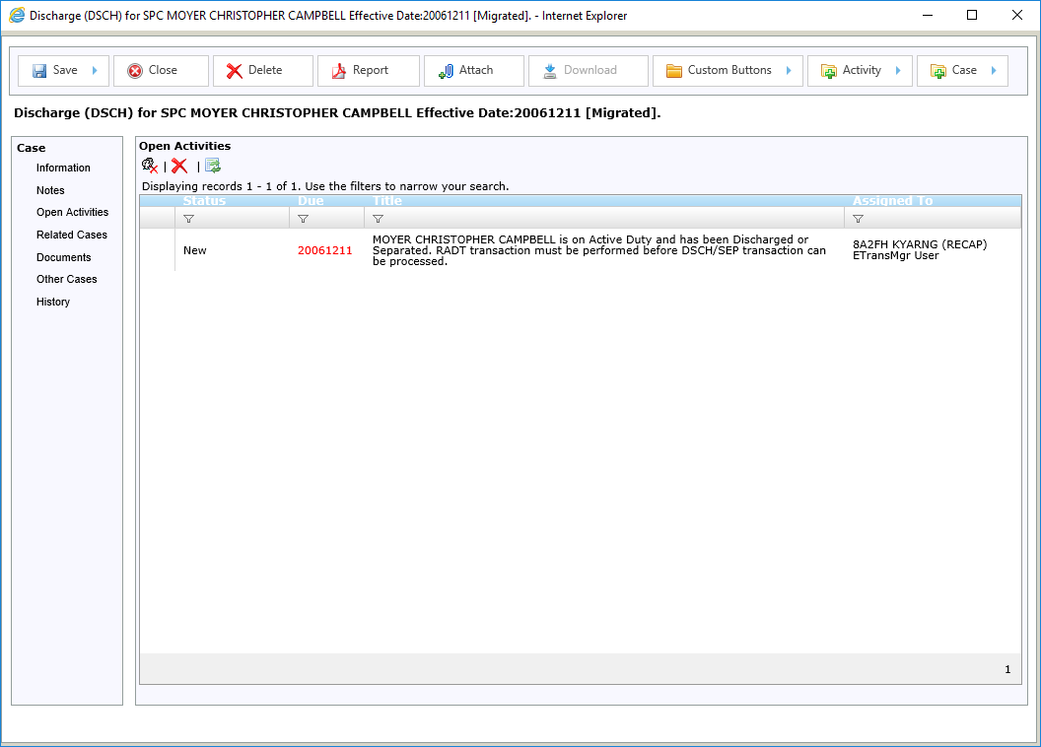
TwinEngines ETrans Migration DSCH/SEP Cases
If a DSCH or SEP transaction is created in MILPO Orders, the system checks to see if the Soldier is on active duty. If they are, the transaction is held and a task is created to perform the RADT transaction prior to releasing the DSCH/SEP transaction.

Slide 42
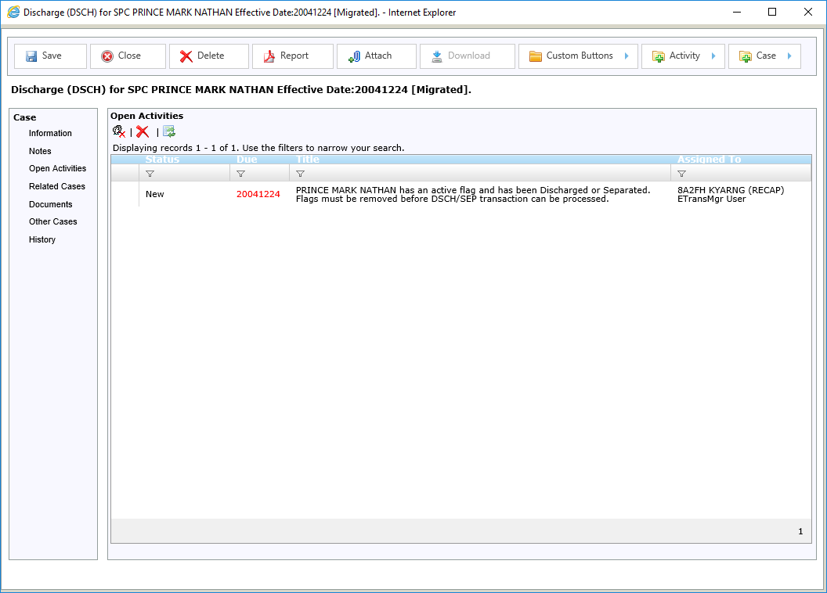
TwinEngines ETrans Migration DSCH/SEP Cases
If a DSCH or SEP transaction is created in MILPO Orders, the system checks to see if the Soldier is flagged. If they are, the transaction is held and a task is created to remove the flags prior to releasing the DSCH/SEP transaction.

Slide 43
TwinEngines ETrans Migration
For questions, live demos, or to request a license key, contact:
Dean Baskin
TwinEngines, Inc.
859-536-2540
dbaskin@twinengines.com

